Slide 1
Datacrowd
Final Presentation
Tsampras Konstantinos Papoutsas Georgios

Slide 2




Mission Statement
Crowd Monitoring in Public Spaces
Problems:
Overcrowding
Disease Transmission Risk [Hospitals, Public Spaces]
Air Quality Considerations [Closed areas, Shops etc.]
Personal Scheduling
Avoid High Traffic Hours or Spaces
Visit recreational spaces during peak popularity
Convoluted Personal Time Schedules
Resource Management
Ineffective Employee timetables
Public Transport Dispatching
Marketing in Public Spaces

Slide 3
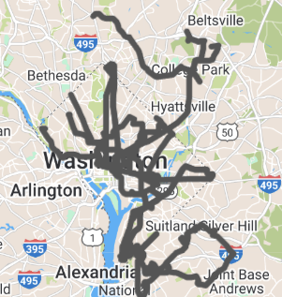
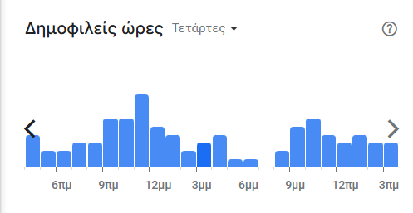
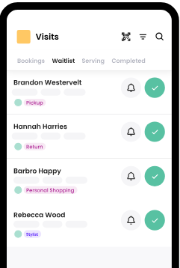
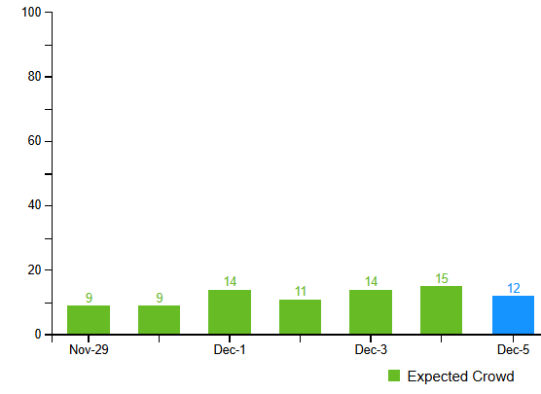
Other solutions
Features/App | Public Transit apps | Avoid crowds | Waitwhile | Google Places API | Foursquare | Datacrowd
Crowd Prediction |  | X | X | X | X | X
Multi-source model |  |  |  |  |  | X
Business & Authorities Insights |  |  | X | X | X | X
Commute Scheduling | X |  |  | X | X | X
https://www.wmata.com/service/status/
https://avoid-crowds.com/
https://waitwhile.com/
https://developers.google.com/maps/documentation/places/web-service
https://foursquare.com/

Slide 4
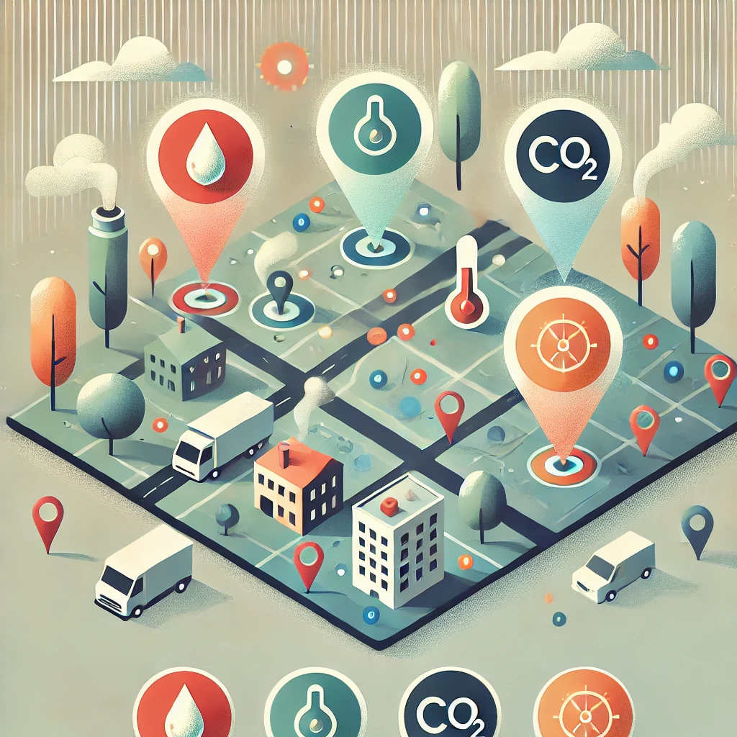


Data sources
Collect data from:
Traffic in public networks (WiFi4EU, Eduroam)
Environmental sensors (CO₂, Temperature, Humidity)
Google places API
Web Scraping Google Maps

Slide 5
Requirements
Target audience
Access to traffic in public networks
Access to the Places API
Sensors (CO₂, Temperature, Humidity) - 169€
Raspberry Pi - 70€
Citizens
Students
Users of Public Transport and Services
Tourists
Authorities and Businesses
Educational Institutions
Municipal Authorities
Private Businesses
Groups of Businesses
https://developers.google.com/maps/documentation/places/web-service/overview
https://mclimate.eu/products/mclimate-co2-sensor-notifier-lorawan?variant=47859023806796
https://www.skroutz.gr/c/688/kameres-parakolouthisis/f/916690/IP.html
https://www.skroutz.gr/s/19212716/Raspberry-Pi-4-Model-B-4GB.html

Slide 6
Features Overview
Inform Public for better decision making
- Real time data and Predictions [heatmaps and graphs]
- Suggestions and Alerts
Commuting citizens using Public Transport
Monitoring Tools for Authorities & Businesses
- Crowd Overview
- Insights for better resource allocation
- Alerting and notifying
Staff scheduling, Efficient police force management, Bus schedule changes
Unique value proposition
- By using 3 data sources, we can analyze and combine the sources in order to create a single crowd predicting model that can provide real-time and more accurate heatmaps about the actual congestion in popular areas.

Slide 7
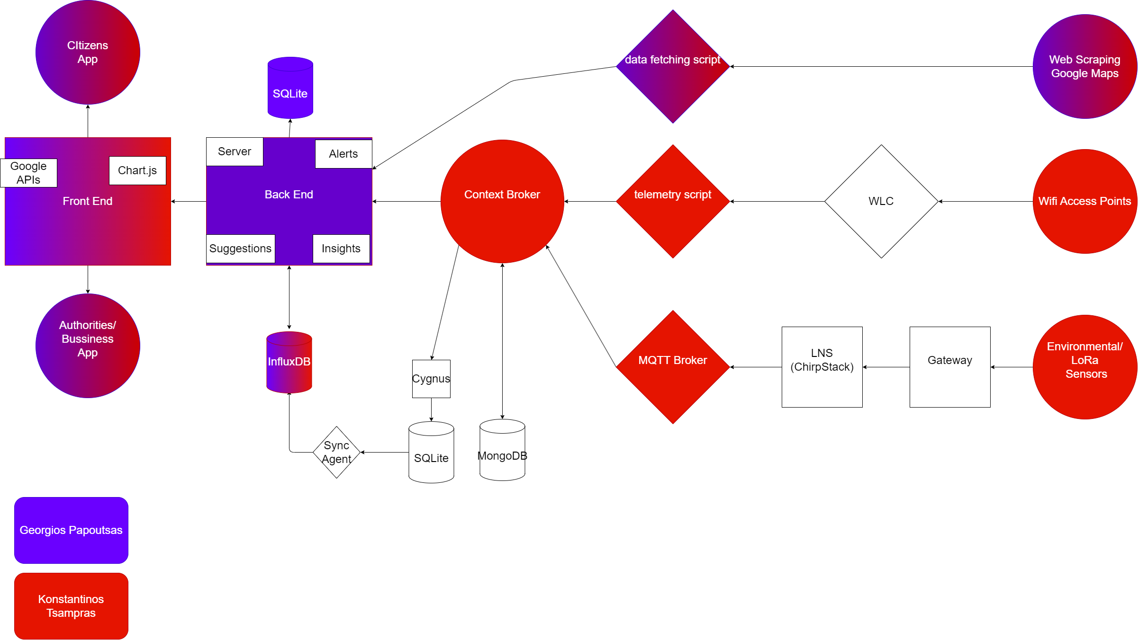
Final App Architecture

Slide 8
DYSKOLIES KAI PRAGMATA POU DEN EGINAN
CAMERES, AI, GOOGLE MAPS API DEN EXEI DEDOMENA

Slide 9
VIDEO DEMO
OWNERSHIP SLIDE
SCRAPING

Slide 10
OWNERSHIP SLIDE
HEATMAPS ME BELAKIA

Slide 11
SCRAPING

Slide 12
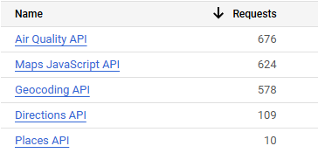
Technologies
Google APIs
Sensor Protocols: LoRa, SNMP
University Lab Infrastructure:
Context Broker
Back End:
Node.js
Front End:
Html, CSS, Handlebars
Databases:
MongoDB, Sqlite3, InfluxDB
Graphs
Chart.js
Smart Data Models:
For sensor data and crowd measurements*
Design:
Figma
https://github.com/smart-data-models/dataModel.Environment/tree/master/AirQualityObserved *
https://github.com/smart-data-models/dataModel.Transportation/tree/master/AnonymousCommuterId
https://github.com/smart-data-models/dataModel.Transportation/tree/master/CrowdFlowObserved
https://github.com/smart-data-models/dataModel.OCF/tree/master/Measurement

Slide 13

Thank you for your time!

